Slide 1


Methods of transferring data on a network

Slide 2

Objectives
At the end of the lesson students should be able to
Outline the operations of circuit switching
Outline the operations of packet switching

Slide 3
Method of transferring data on a network
There are several methods for transferring data on a network. The choice of method depends on the specific requirements of the application, the network architecture, and the type of data being transmitted.
Here are some common methods:
Circuit switching
Packet switching

Slide 4
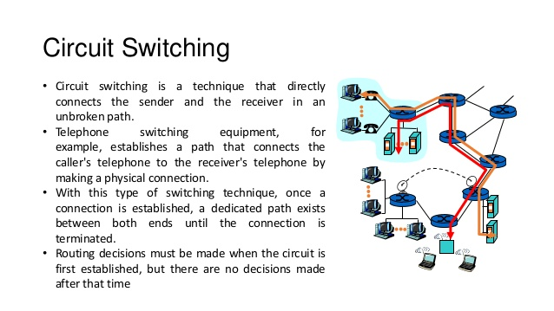
Circuit switching
Circuit switching is a method of establishing a direct communication path between two devices in a network.
It creates a dedicated and continuous link between the sender and the receiver for the duration of the communication session.

Slide 5
CIRCUIT SWITCHING
When sending data across a network using circuit switching, there are three stages:
A circuit/channel between sender and receiver must be established.
Data transfer then takes place (which can be analogue or digital); transmission is usually bi-directional.
After the data transfer is complete, the connection is terminated.

Slide 6
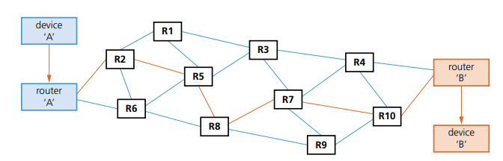
How circuit switching works
The dedicated route from ‘A’ to ‘B’ is first of all established (shown in orange on the diagram). The following connections are then partially implemented: A–R2, R2–R5, R5–R8, R8–R7, R7–R10 and finally R10–B.
All packets (frames) follow this single route and communication will take place, provided ‘B’ is not busy.
The main uses of circuit switching include public telephone networks, private telephone networks and private data networks

Slide 7
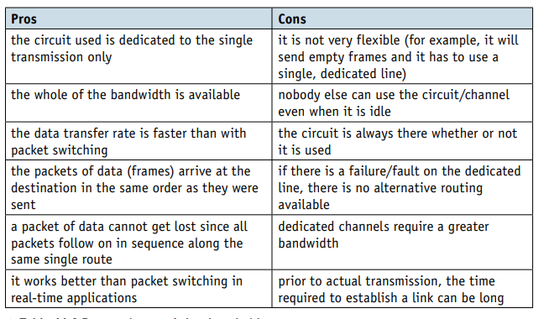
Circuit switching

Slide 8
PACKET SWITCHING
Packet switching is a data transmission method used in computer networks.
It breaks data into small, fixed-size units called packets, which are then sent individually over the network.
These packets can take different routes to reach their destination and are reassembled at the receiver. This method contrasts with circuit switching, where a dedicated path is established for the duration of a communication session.

Slide 9
PACKET SWITCHING
Each packet follows its own path
Routing selection depends on the number of datagram packets waiting to be processed at each node (router)
the shortest path available is selected
packets can reach the destination in a different order to that in which they are sent

Slide 10
PACKET SWITCHING
Each packet contains a header and a payload.
Information in the header
Source Address: Indicates the address of the sender or the origin of the packet.
Destination Address: Specifies the address of the intended recipient or the final destination of the packet.
Sequence Number: Provides a unique identifier for the packet. This helps in reassembling packets at the receiver in the correct order.
Acknowledgment Number: In some protocols, such as TCP (Transmission Control Protocol), this field is used to acknowledge the receipt of a packet, especially in scenarios where reliable delivery is crucial.
Checksum or CRC (Cyclic Redundancy Check): Contains a calculated value based on the contents of the packet. This value is used for error detection. If the packet arrives with an incorrect checksum, it may indicate that the packet has been corrupted during transmission.
Length or Payload Size: Specifies the size of the data payload (the actual information being transmitted) in the packet.
Time-to-Live (TTL): Prevents packets from circulating endlessly in the network. TTL is decremented by one each time the packet traverses a router. When TTL reaches zero, the packet is discarded

Slide 11
Time-to-Live (TTL):
Sometimes it is possible for packets to get lost and keep ‘bouncing’ around from router to router and never actually get to their destination. Eventually, the network could grind to a halt as the number of ‘lost’ packets mounts up and clogs up the system.
To overcome this, a method called hopping is used. A hop number is added to the header of each packet. Each packet is only allowed to hop a certain number of times (this number is determined by the network protocol and routing table being used).
Each time a packet passes through a router, the hop number is decreased by 1.
If the packet has not reached its destination and the hop number = 0, then it will be deleted when it reaches the next router.

Slide 12
ROUTING TABLE
Routing tables contain the information necessary to forward a package along the shortest/best route to allow it to reach its destination. As soon as the packet reaches a router, the packet header is examined and compared with the routing table. The table supplies the router with instructions to send the packet (hop) to the next available router.

Slide 13
ROUTING TABLE
Routing tables include
number of hops
MAC address of the next router where the packet is to be forwarded to (hopped)
metrics (a cost is assigned to each available route so that the most efficient route/path is found)
network destination (network ID) or pathway
gateway (the same information as the next hop; it points to the gateway through which target network can be reached)
netmask (used to generate network ID)
interface (indicates which locally available interface is responsible for reaching the gateway)

Slide 14
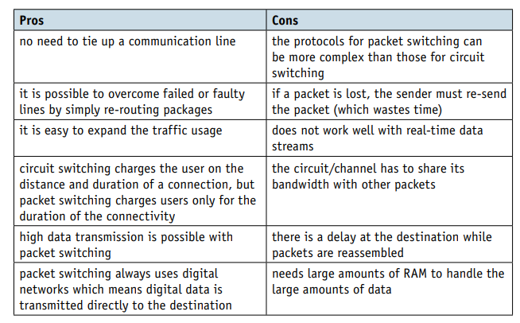
PACKET SWITCHING

Slide 15
Ingress and Egress Filtering: Configuring routers and firewalls to inspect and enforce acceptable TTL values for incoming and outgoing traffic.
Anomaly Detection: Implementing network monitoring and anomaly detection systems to identify and alert on unusual TTL patterns that could indicate an attack.
Secure Routing Protocols: Ensuring that routing protocols, such as BGP, are properly configured and secured to prevent the propagation of malicious routing information.
Endpoint Security: Enforcing security policies on end-user devices to prevent them from being used as attack vectors for TTL Manipulation

Slide 16
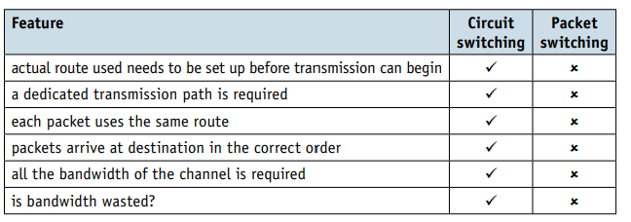
PACKET/CIRCUIT SWTICHING

